Slide 1


FREDERICKV ALBORNOZ ESCOBEDO
19th December, 2023

Slide 2

Outline
Executive Summary
Introduction
Methodology
Results
Conclusion
Appendix

Slide 3
Executive Summary
Prediction if the Falcon 9 first stage will land successfully
Collecting data on the Falcon 9 first-stage landing
See interactive Plotly Dash
Applying Machine Learning to determine if the first stage of Falcon 9 will land successfully

Slide 4
Introduction
SpaceX advertises Falcon 9 rocket launches on its website, with a cost of 62 million dollars; other providers cost upward of 165 million dollars each, much of the savings is because SpaceX can reuse the first stage.
Therefore, if we can determine if the first stage will land, we can determine the cost of a launch. This information can be used if an alternate company wants to bid against SpaceX for a rocket launch.

Slide 5

Section 1

Slide 6
Methodology
Executive Summary
Data collection methodology:
Request to the SpaceX API
Clean the requested data
Perform data wrangling
Extract a Falcon 9 launch records HTML table from Wikipedia
Parse the table and convert it into a Pandas dataframe
Perform exploratory data analysis (EDA) using visualization and SQL
Perform interactive visual analytics using Folium and Plotly Dash
Perform predictive analysis using classification models
Create a column for the class, Standardize the data, Split into training data and test data, Find the method perform best using test data

Slide 7
Data Collection
We collected dataset about SpaceX using:
SpaceX REST API
Response JSON and normalizing the data to turn it into a Pandas dataframe
Getting information about launches using the IDs given for each launch
Applying getBoosterVersion tocreate a Pandas data frame
Dealing with Missing Values
Wikipedia
Request the Falcon9 Launch Wiki page from its URL
Extract all column/variable names from the HTML table header using BeautifulSoup
Create a data frame by parsing the launch HTML tables

Slide 8
Data Collection – SpaceX API
Dataset is collected using the SpaceX API, using ger requests in Python. Then we normalized JSON data. After that we converted dictionary to DataFrame, filtered it and clean missing values.
Results shown here: Data Collection – SpaceX API
Getting data in JSON format and its normalizing
Getting information using the IDs for new columns
Creating new data frame and combining it to dictionary
Filtering the data to get only about Falcon 9
Finding missing values of dataset and dealing with it

Slide 9
Data Collection - Scraping
First, we did the request to get content using BeautifulSoup. After that we extract all column names from HTML table header and created a data frame by parsing the HTML.
Results shown here: Data Collection - Scraping
Requesting the Falcon9 and Launching page from its URL
Extracting objects of table type for getting columns
Parsing data
Creating dataframe

Slide 10
Data Wrangling
For data wrangling we performed Exploratory Data Analysis (EDA) and found some patterns in data:
Identify and calculate the percentage of the missing values in each attribute, also identify types of columns
Calculate the number of launches on each site
Calculate the number and occurrence of each orbit
Calculate the number and occurrence of mission outcome of the orbit
Create a landing outcome label from Outcome column
Results shown here: Data wrangling

Slide 11
EDA with Data Visualization
As a result, we got visualization of the relationship between Flight Number and Launch Site, Payload and Launch Site, success rate of each orbit type, FlightNumber and Orbit type, Payload and Orbit type. Visualize the launch success yearly trend.
Also, we made some features engineering:
Create dummy variables to categorical columns
Cast all numeric columns to `float64` using one hot encoding
Results shown here: Data wrangling

Slide 12
EDA with SQL
After connecting to database, we performed EDA with SQL by executing queries to get some insights from data:
unique launch sites
launch sites which begin with ‘CCA’
total payload mass carried by boosters launched by NASA (CRS)
average payload mass carried by booster version F9 v1.1
the date when the first successful landing outcome
the names of the boosters which have success in drone ship
the total number of successful and failure mission outcomes
the names of the booster_versions which have carried the maximum payload mass
the month names, failure landing_outcomes in drone ship, booster versions, launch_site for the months in year 2015
the count of landing outcomes (such as Failure (drone ship) or Success (ground pad)) between the date 2010-06-04 and 2017-03-20
Results shown here: EDA with SQL

Slide 13
Build an Interactive Map with Folium
During building an interactive map with Folium we used:
Circles: To mark region where is something placed
Markers: To highlight the name of circles
Marker Cluster: To simplify the map as it contains a lot of markers in the same or almost the same coordinates
Mouse Position: To get a coordinates of position where mouse placed at a map
Polyline: To draw a line from coordinate1 to coordinate2 and show distance
Adding this interactive things, we simplify understanding of map and our results
Results shown here: Launch Sites Locations Analysis with Folium

Slide 14
Build a Dashboard with Plotly Dash
During building a Dashboards we added:
a dropdown list which shows all launch sites
a pie chart to show the total successful launches count for all sites and for specific launch site show the Success vs. Failed counts for the site
a slider to select payload range
a scatter chart to show the correlation between payload and launch success
This plots and interaction allows us quickly visualize very useful information.
Results shown here: Application with Plotly Dash

Slide 15
Predictive Analysis (Classification)
After loading our datasets, we normalize it and split it on test and on train datasets.
After that we make experiments and trying to fit our data to different methods of ML. We created:
Logistic Regression Model
Support Vector Machine
Decision Tree
K-neighbors Classifier
After that we calculated the score and show confusion matrix of each method
Results shown here: Machine Learning Prediction

Slide 16
Results
Exploratory data analysis results
The more flights, the more payload mass needed
Rate of success depends on orbit type and number of flights
Depending on orbit type, we can understand how many payload mass we need
Success rate grown with newer technologies
Interactive analytics
Launch sites close to Equator, coastline, railway and highway, but not close to cities
Predictive analysis results
The best results of prediction shows Decision Tree method and the lowest accuracy have KNN method

Slide 17

Section 2

Slide 18
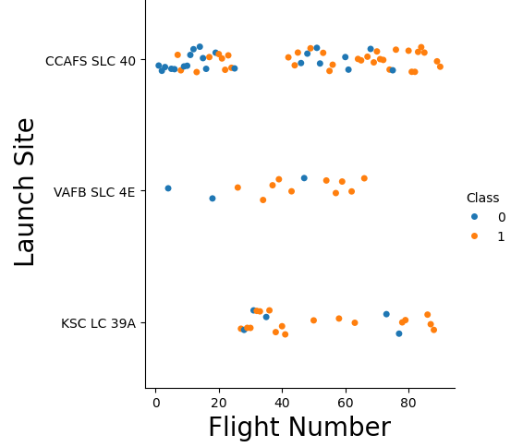
Flight Number vs. Launch Site
The highest number of flights was made from CCAFS SLC 40. At the same time, this launch site have the highest number of flights. A lot of flights was failure.

Slide 19
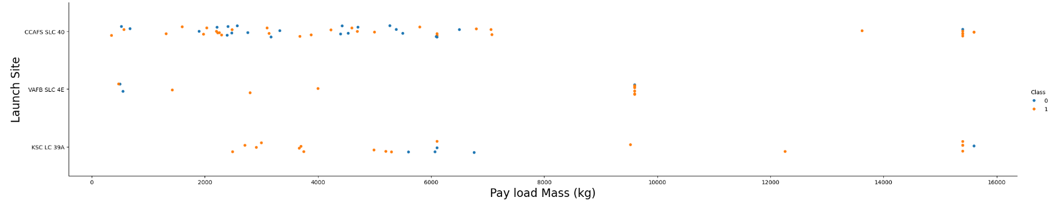
Payload vs. Launch Site
This scatter shows that most of flights have payload mass less then 8000 kg. Launch site called VAFB SLC 4E did not have payload mass more then 10 000 kg.

Slide 20
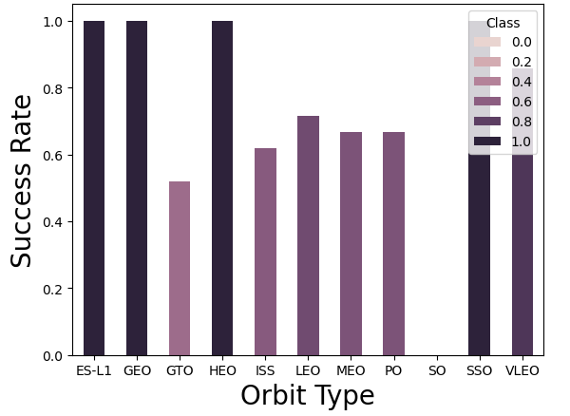
Success Rate vs. Orbit Type
This bar chart shows that orbit SO does not have success rate. ES-L1, GEO, HEO and SSO orbit types have 100% success rate.

Slide 21
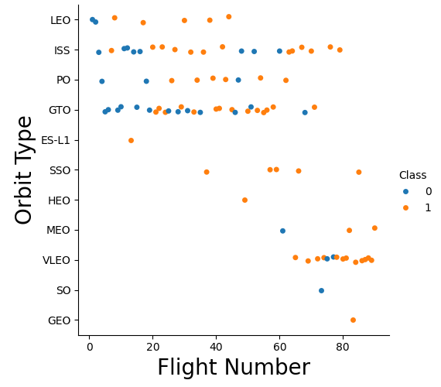
Flight Number vs. Orbit Type
Flights to LEO, ES-L1, HEO and SSO orbits with increasing number of flights become successful. At the same time, flights to GTO, ISS, PO and VLEO orbits did not depends on flight number.

Slide 22
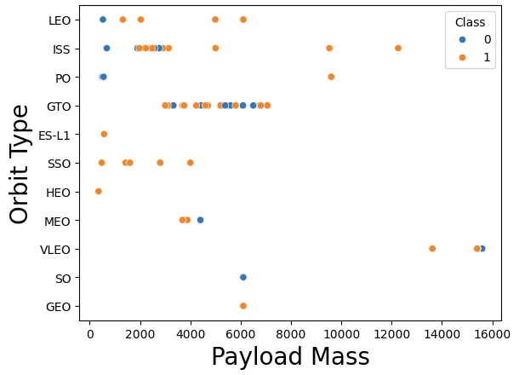
Payload vs. Orbit Type
Flights to most of orbits need less payload mass then 8 000.
Flight to VLEO needs more then 12 000 payload mass.

Slide 23
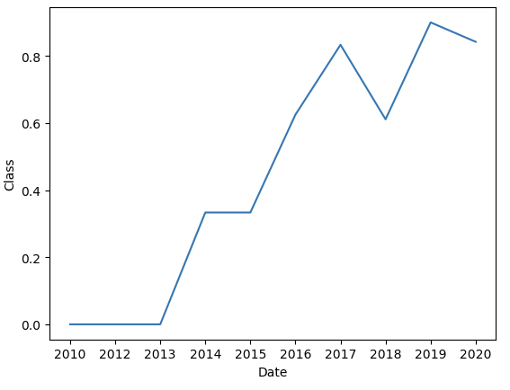
Launch Success Yearly Trend
From 2010 to 2013 rate was fully failure.
From 2013 rate becomes bigger and bigger yearly.

Slide 24
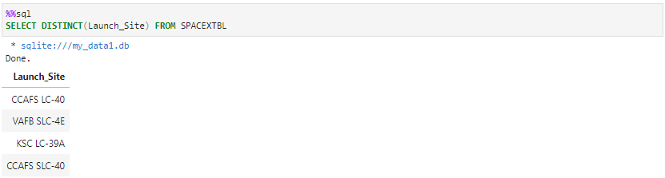
All Launch Site Names
The names of the unique launch sites

Slide 25
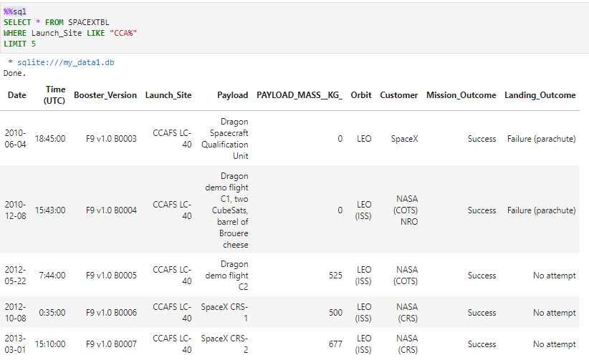
Launch Site Names Begin with 'CCA'
5 records where launch sites begin with `CCA`

Slide 26
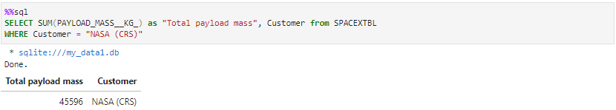
Total Payload Mass
The total payload carried by boosters from NASA

Slide 27
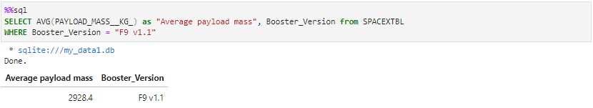
Average Payload Mass by F9 v1.1
The average payload mass carried by booster version F9 v1.1

Slide 28
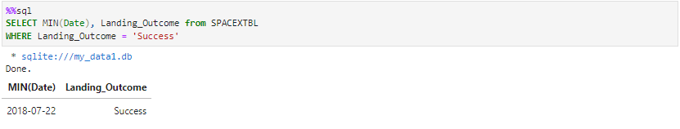
First Successful Ground Landing Date
The date of the first successful landing outcome on ground pad

Slide 29
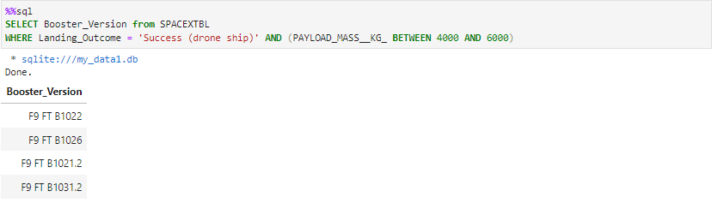
Successful Drone Ship Landing with Payload between 4000 and 6000
The names of boosters which have successfully landed on drone ship and had payload mass greater than 4000 but less than 6000

Slide 30
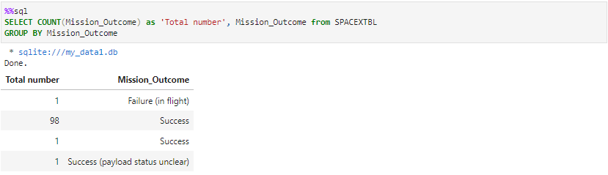
Total Number of Successful and Failure Mission Outcomes
The total number of successful and failure mission outcomes

Slide 31
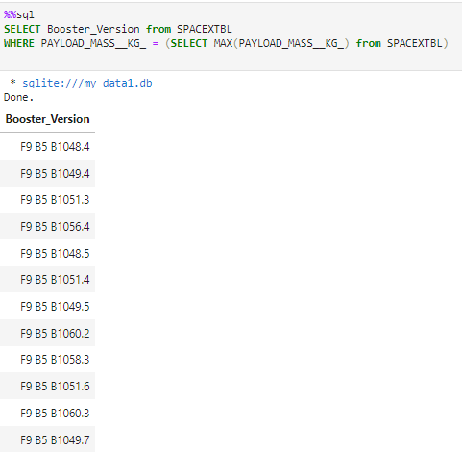
Boosters Carried Maximum Payload
The names of the booster which have carried the maximum payload mass

Slide 32
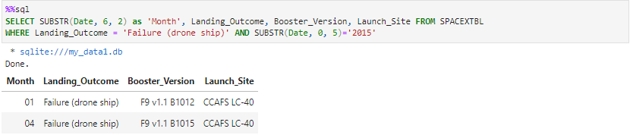
2015 Launch Records
The failed landing_outcomes in drone ship, their booster versions, and launch site names for in year 2015

Slide 33
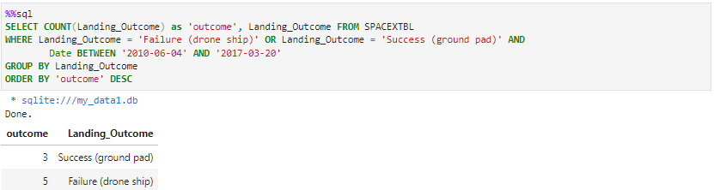
Rank Landing Outcomes Between 2010-06-04 and 2017-03-20
The count of landing outcomes (such as Failure (drone ship) or Success (ground pad)) between the date 2010-06-04 and 2017-03-20, in descending order

Slide 34

Section 3

Slide 35
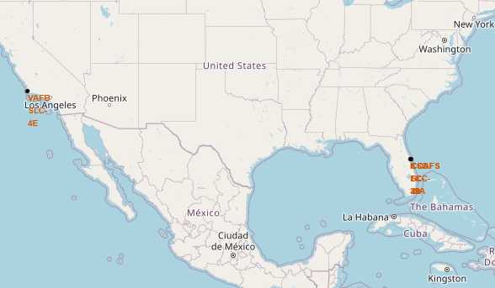
All launch sites
There is shown all launch sites. As we can see, they placed close to Equator line and to the coasts.

Slide 36
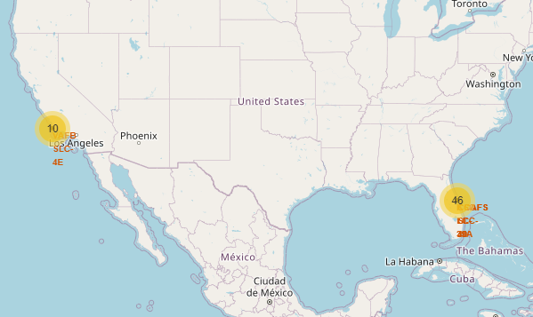
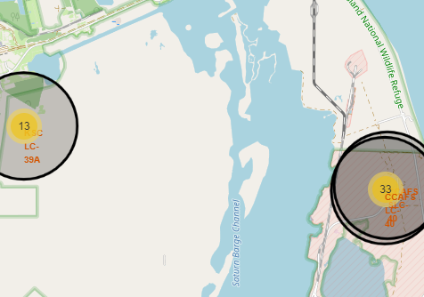
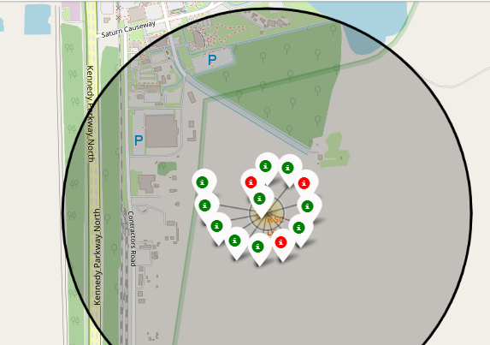
Color-labeled outcomes
From the color-labeled markers, we are be able to easily identify which launch sites have relatively high success rates.
Green markers = success and red markers = failure

Slide 37
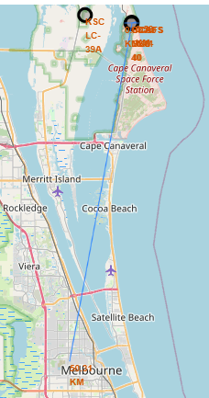
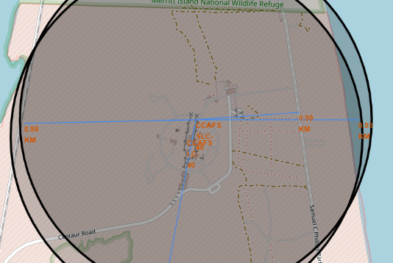
Distance from a launch site
Here is shown distance from one launch site to closest railway, highway and coastline. Also, here is shown distance to Malbourne.

Slide 38

Section 4

Slide 39
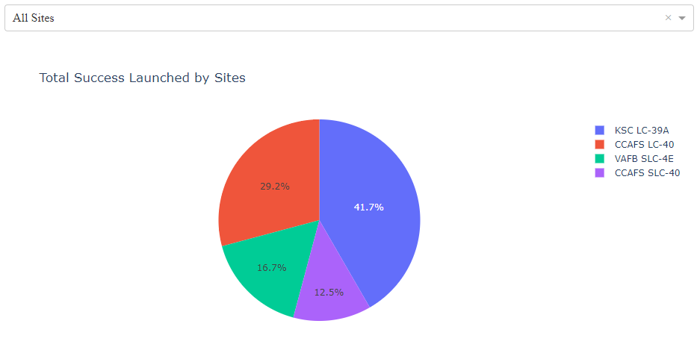
Total success launched by sites
The pie chart shows percentage of successful launch comparing with other sites

Slide 40
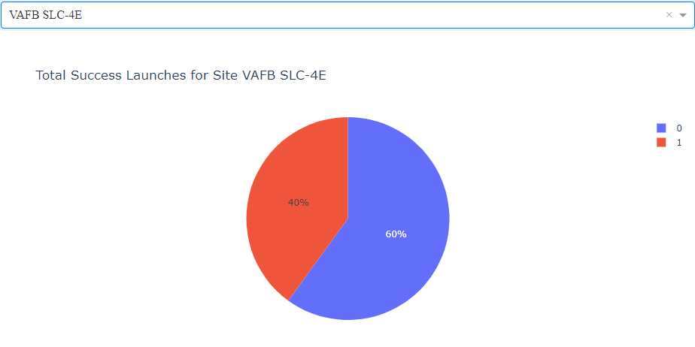
Total Success Launches for Site VAFB SLC-4E
Here is shown percentage of successful launch comparing to failure for VAFB SLC-4E. Successful rate is 40%

Slide 41
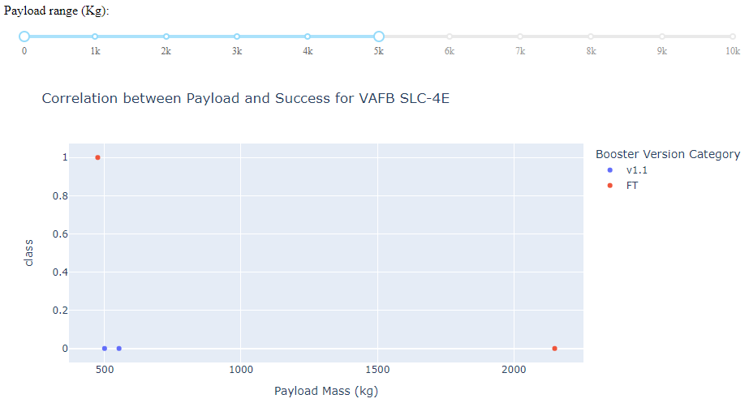
Correlation between Payload and Success for
VAFB SLC-4E
Here is shown outcomes for VAFB SLC-4E for payload from 0 to 5000 kg. Also, shown for what booster version is success or failure.

Slide 42

Section 5

Slide 43
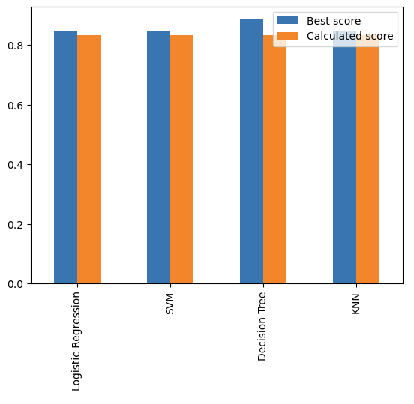
Classification Accuracy
As we can see, all test score are same. But the best accuracy shows Decision Tree Classifier with best score.

Slide 44
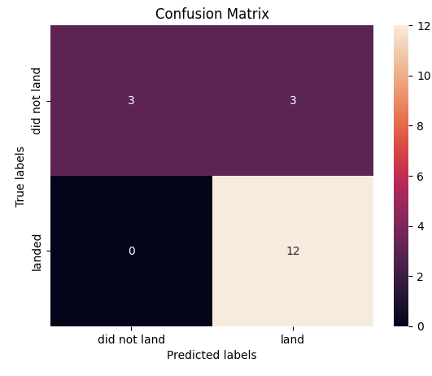
Confusion Matrix
Prediction about landing absolutely predicted well, however it is hard to predict failure landing.

Slide 45
Conclusions
KSC LC-39A rate have most of successful launches.
Decision Tree Classifier works better for prediction.
All of sites close to Equator and seacoasts.
Success of mission can depend on orbit type.
Since 2013 percentage of successful flights increasing.

Slide 46


